Slide 1
Elder Fraud – Financial Abuse Trends Irina Balashova, CPA, CFE, CIA Howard Silverstone, CPA, CFF, CFE Forensic Resolutions, Inc. Rutgers Business School in conjunction with the Association of Certified Fraud Examiners – New Jersey Chapter
JUNE 7, 2019

Slide 2
Howard Silverstone MBE, CPA, CFF, FCA, CFE
Howard Silverstone is a Managing Director of Forensic Resolutions, Inc.
Howard recently served on the AICPA Forensic & Litigation Services Committee and was Chair of the Fraud Task Force.
Howard is also a member of the Pennsylvania Society of CPAs.
Howard has written several books on Forensic Accounting and Fraud issues.
He is a graduate of London Metropolitan University, London, England.
Howard is also a UK Chartered Accountant.

Slide 3
Irina Balashova CPA, Cia, Cfe
Irina Balashova is an Associate at Forensic Resolutions, Inc.
Irina is a member of AICPA, ACFE, IIA, and New Jersey Society of CPAs.
She is a Board Member of ACFE – Philadelphia Chapter.
Irina published articles on Fraud and Forensics.
She has a Master’s Degree in Business Administration from Louisiana State University.
She has a Master’s Degree in Engineering from Bauman Moscow State Technical University, Russia.

Slide 4
When Someone illegally or improperly uses a vulnerable senior’s money or other resources
What is Elder Fraud?
What is at stake:
Retirement savings
Home Equity
Social Security Income
Heritage
The population that is retiring is one of the wealthiest, if not the wealthiest generation, in terms of their retirement savings
Population trends
Changing technology
Demographic changes and wealth
Notes:
https://smartasset.com/retirement/average-retirement-savings-are-you-normal
according to the Government Accountability Office (GAO), around 29% of households age 55 and older have neither retirement savingsnor a pension.
Research by the Federal Reserve found that the median retirement account balance in the U.S. (looking only at those who actually have retirement accounts) was just $59,000 in 2013.
It isn’t just retirement accounts that Americans lack. Looking at overall net worth tells a similar story. According to the Census Bureau, the (median) average net worth excluding home equity for an American 35-44 years old is $14,226. In the 55-64 age range, average net worth is $45,447. The picture of Americans’ net worth looks better if you include home equity, but not every American will be able to tap into that equity to pay for retirement.
For many Americans, Social Security benefits are the only source of income during their retirement. Social Security was never meant to be the sole source of retirement income. Retired workers average a monthly Social Security benefit of $1,354.04 as of October 2016.
"This population that's retiring is one of the wealthiest, if not the wealthiest generation, in terms of their retirement savings," said Rothman, who is also the Minnesota commissioner of commerce. "Criminals know this as well
https://www.cnbc.com/2017/08/25/elder-financial-fraud-is-36-billion-and-growing.html

Slide 5
The Growing Senior Population
By 2030, 1 in every 5 residents will be of retirement age
Notes:
SEPT. 6, 2018 — The year 2030 marks an important demographic turning point in U.S. history according to the U.S. Census Bureau’s 2017 National Population Projections. By 2030, all baby boomers will be older than age 65. This will expand the size of the older population so that 1 in every 5 residents will be retirement age.
“The aging of baby boomers means that within just a couple decades, older people are projected to outnumber children for the first time in U.S. history,” said Jonathan Vespa, a demographer with the U.S. Census Bureau. “By 2035, there will be 78.0 million people 65 years and older compared to 76.7 million (previously 76.4 million) under the age of 18.”
As the population ages, the ratio of older adults to working-age adults, also known as the old-age dependency ratio, is projected to rise. By 2020, there will be about three-and-a-half working-age adults for every retirement-age person. By 2060, that ratio will fall to just two-and-a-half working-age adults for every retirement-age person.
The median age of the U.S. population is expected to grow from age 38 today to age 43 by 2060.
https://www.nolo.com/legal-encyclopedia/elder-abuse-financial-scams-against-29822-2.html
10,000 Americans will turn 65 every day
through 2050
That is equivalent to:
More than 2x the population of Philadelphia every year.
Nearly the entire population of New York City every two years.
More than the entire population of Spain by 2030.

Slide 6
Elder Fraud Victims Profile
Elder Fraud SCAMMERS Profile
Who are at greater risk:
Being a woman
Dementia / poor physical health
Experience of previous traumatic events
Low social support
Stay home
Expect honesty in the marketplace
Less knowledgeable about their rights in an increasingly complex marketplace
Lower income or poverty
Who they are:
>58% are a spouse or an adult child, >20% are neighbors or friends, >13% are paid help/service providers
Most likely a male
Issues with law
Substance abuse
Financial difficulties
Stress
Unemployment
World Elder Abuse Awareness Day (WEAAD) was launched on June 15, 2006 by the International Network for the Prevention of Elder Abuse and the World Health Organization at the United Nations (UN)
Notes:
A recent study by the American Association of Retird Persons (AARP) highlighted characteristics of people older than 50 that make them easy targets for financial abuse. In general, they:
expect honesty in the marketplace,
are less likely to take action when defrauded,
and are less knowledgeable about their rights in an increasingly complex marketplace.
And as people over 50 are more likely to be home than their younger neighbors, they are often within easy reach of devious telemarketers and home solicitors.
https://www.nolo.com/legal-encyclopedia/elder-abuse-financial-scams-against-29822.html
Scammers target elders that they perceive to be vulnerable -- those that are isolated, lonely, physically or mentally disabled, unfamiliar with handling their own finances, or have recently lost a spouse. https://www.washingtonpost.com/news/posteverything/wp/2017/06/15/who-are-the-victims-of-elder-abuse-the-disabled-cognitively-impaired-and-poor/?noredirect=on&utm_term=.e46aa29793c6
https://acl.gov/news-and-events/events-and-observances/world-elder-abuse-awareness-day
World Elder Abuse Awareness Day (WEAAD) was launched on June 15, 2006 by the International Network for the Prevention of Elder Abuse and the World Health Organization at the United Nations (UN).

Slide 7
Legislation
Elder Abuse Prevention & Prosecution Act – enacted in 2017
Authorizes the Department of Justice (DOJ) to take steps to combat elder abuse. Under the new law, the federal government must do the following:
Create an elder justice coordinator position in federal judicial districts, at the DOJ, and at the Federal Trade Commission
Implement comprehensive training on elder abuse for Federal Bureau of Investigation agents
Operate a resource group to assist prosecutors in pursuing elder abuse cases
February 22, 2018 Press Conference, FBI: Opened more than 200 financial crime cases that involved elderly victims
United States Senate Special Committee on Aging
2018 Fraud Book, featuring top ten scams reported in 2017, along with prevention and fighting resources list
Notes:
The law requires the DOJ to collect data on elder abuse and investigations as well as provide training and support to states to fight elder abuse.
The law specifically targets email fraud by expanding the definition of telemarketing fraud to include email fraud. Prohibited actions include email solicitations for investment for financial profit, participation in a business opportunity, or commitment to a loan.
https://www.elderlawanswers.com/new-federal-law-puts-focus-on-preventing-elder-abuse-16590
https://bellomoassociates.com/2017/12/17/new-federal-law-passed-to-protect-the-elderly/
https://www.fbi.gov/news/stories/elder-fraud-charges-announced
Other agencies participating in today’s announcement included the U.S. Postal Inspection Service and the Federal Trade Commission, which actively investigate elder fraud, and, like the FBI, offer educational material and other resources to senior citizens so they can become more aware of the threat. A coordinated law enforcement action aimed at those who prey on senior citizens has resulted in charges against more than 250 subjects who collectively victimized more than one million mostly elderly Americans.
http://www.eldersandcourts.org/elder-abuse/elder-abuse-material-for-right-rail-menu-for-elder-abuse/basics/elder-abuse-laws.aspx

Slide 8
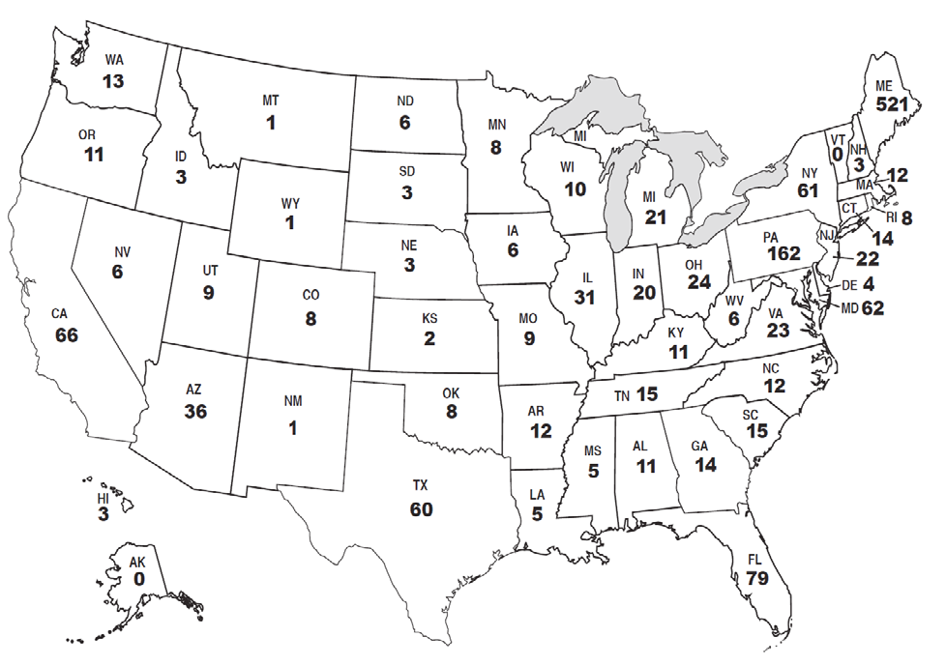
Top Ten Types of Scams
IRS Impersonation Scam
Robocalls/Unsolicited Phone Calls
Sweepstakes/Jamaican Lottery Scam
“Can you hear me?” Scam
Grandparent Scam
Computer Scam
Romance Scam
Elder Financial Abuse
Identity Theft
Government Grant
Notes:
Origin of Calls Received by the Aging Committee Fraud Hotline from January 1, 2017, to December 31, 2017.
Over the past year, more than 1,400 individuals all across the country contacted the Fraud Hotline.
One of the Senate Aging Committee’s top priorities in the 115th Congress is to continue combatting fraud that targets seniors. e Fraud Hotline has been instrumental in this ght, providing more than 1,400 people in 2017 with information on common scams and o ering tips on how to avoid becoming victims of fraud. In addition, Fraud Hotline investigators have encouraged victims to report fraud to the appropriate law enforcement agencies to improve the government’s data as well as its ability to prosecute the perpetrators of these scams. Committee investigators have even helped some victims recover thousands of dollars of their hard-earned retirement savings.
e Aging Committee has held hearings on seven of the top ten scams on this list. e Committee’s hearings have helped raise public awareness to prevent seniors from falling victim to these scams, as well as to provide valuable oversight of the federal government’s e ort to combat these frauds and protect consumers. e Committee has pressed federal law enforcement agencies to combat fraud and put the criminals who prey on our nations’ seniors behind bars.

Slide 9
IRS Impersonation Scam
Did you receive THE call recently?
Criminals generally accuse victims of owing back taxes and penalties
They threaten retaliation
A Caller-ID spoofing is a tactic used by the scammers

Slide 10
Robocalls/Unsolicited Phone Calls
Do you feel that you began receiving more of these lately?
Robocalling allows scammers to maximize the number of individuals and households they reach
Robocalls are originated by recordings and are designed to identify numbers that consumers are likely to answer
VoIP technology sends voice communications over the internet
Scammers pose as representatives of banks, credit card companies, creditors, or government agencies

Slide 11
Sweepstakes/Jamaican Lottery Scam
Scammers contact victims by phone or through mail to tell them they have won or have been entered to win a prize
Tell the victims to send money in a variety of ways
Money scammed from victims help fund organized crime in the island nation
Con artists adopt a variety of identities to keep the money coming in ever- increasing amounts

Slide 12
“Can you hear me?” Scam
Caller would simply ask “Are you there?” or “Can you hear me?” in order to prompt the recipient to say “yes.”
Scammers would record the consumer’s voice, and thus obtain a voice signature,
Use the recording to authorize unwanted charges on items like utility bills, phone bills, or even stolen credit cards

Slide 13
Grandparent Scam
Imposters either pretend to be the victim’s grandchild and/or claim to be holding the victims’ grandchild
Play on victims’ emotions and trick concerned grandparents into wiring money to them
Requires the victim to go to a local retailer and send an electric wire transfer of several thousand dollars

Slide 14
Computer Scam
Scam involves con artists trying to gain victims’ trust by pretending to be associated with a well-known technology company, such as Microsoft, Apple, or Dell
Victims unknowingly contact scammers
Ransomware
Fraudulent refund

Slide 15
Romance Scam
2016: 15% of adult Americans used online dating services
Out of those, 12% are 55 to 64, which is a 6% increase from 2013
Scammers contact victims online either through a chatroom, dating site, social media site, or email
Create elaborate profile pages, giving their fabricated story more credibility
Con artists often call and chat on the phone to prove that they are real
Be aware of “destiny” or “fate”
Money requests
Delay or avoid in-person meeting

Slide 16
Elder Financial Abuse
Most victims are between the ages of 80 and 89, live alone, and require support with daily activities
Perpetrators include family members, paid home care workers, those with fiduciary responsibilities, such as financial advisors or legal guardians or strangers who defraud older adults through mail, telephone, or Internet scams

Slide 17
Identity Theft
Draining bank accounts, marking unauthorized credit card charges, and damaging credit reports
Often defraud the government and taxpayers by using stolen personal information to submit fraudulent billings to Medicare or Medicaid, or apply for an receive Social Security benefits to which they are not entitled

Slide 18
Government Grant Scam
Most common variation of this scam, consumers receive and unsolicited phone call from con artists claiming that they are from the “Federal Gants Administration,” or the “Federal Grants Department” – agencies that do not exist
Another version of this scam, scammers place advertisements in the classified section of local newspapers offering “free grants,” and will request that victims wire money for processing fees or taxes before the money can be sent to them

Slide 19
What to Look For /Signs of Elder Financial Abuse
Unpaid Bills
Sudden Change in Lifestyle
Forged Signatures
Sudden Accrual of Debt
Sudden Sale or Change in Title of Home, Land or Assets
Unexplained Transfer of Funds
Power of Attorney or Will Changed Under Unusual Circumstances
Sudden Changes in Withdrawal Amounts
Elder Complaints About Missing Money or Assets
Elder Reports Financial Abuse

Slide 20
Countering the Problem
It is up to relatives and those with financial expertise, such as CPAs, to continually educate and inform elderly family members and clients, or clients with elderly family members. Just like all frauds, understanding the red flags and conducting due diligence is key
Safety
Rapport
Documentation
Take Notes
Understand Cognitive Impairment Signs
Stay Tuned for the Latest Developments in Rules and Regulations
Reach out for Help and/or Advise
Spread the Knowledge

Slide 21
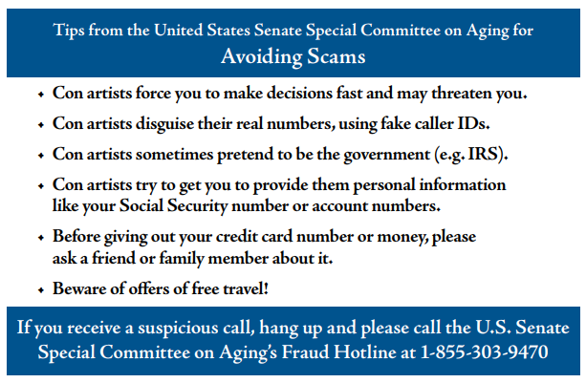
Resources
Agency | Website | Phone Number
Local/State AG Office | http://www.naag.org/current-attorneys-general.php
National Adult Protection Services Association | Find local APS Association: www.napsa-now.org/get- help/help-in-your-area/
DOJ Elder Justice Initiative | www.justice.gov/elderjustice/ | 1-202-514-2000 (DOJ Main Switchboard)
Financial exploitation | www.eldercare.gov | 1-800-677-1116
Center for Elder Rights Advocacy | http://www.legalhotlines.org/legal-assistance- resources.html

